Slide 1

How to Win an Evenly Matched 18th Century Naval Battle
By Lawrence Hua, Carnegie Mellon University MISM

Slide 2
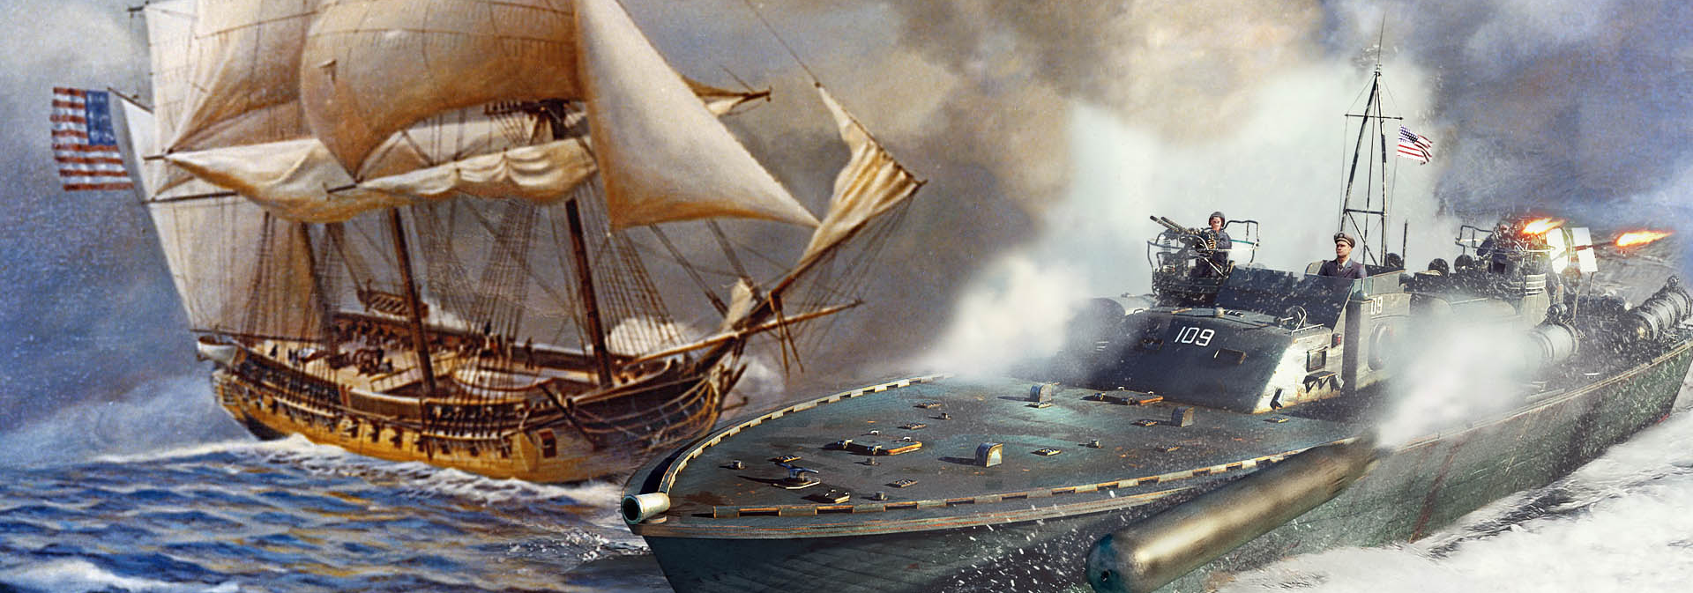
What is a Naval Battle?
Naval Battle is the tactics of military operations
and armed forces conducted on, under, or over the sea.
Notes:
Britanna source

Slide 3


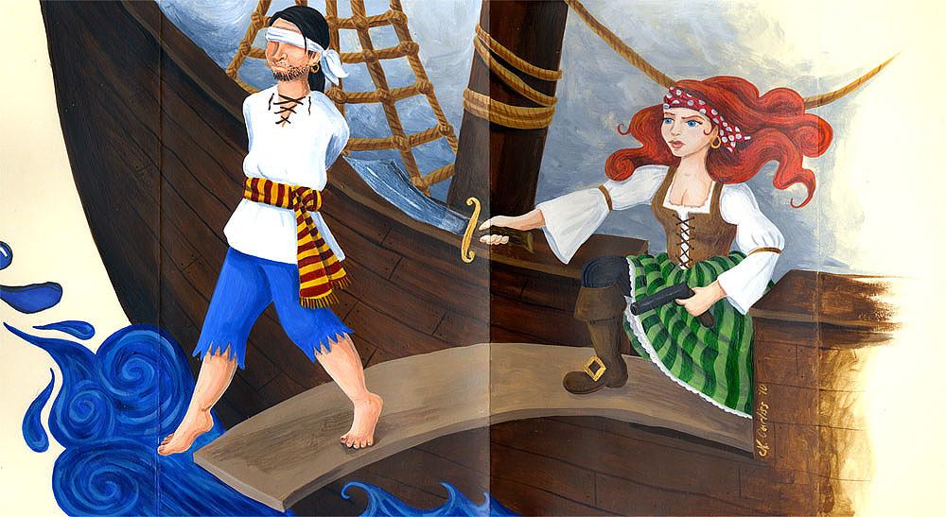
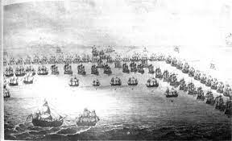
Transitioning from 17th to 18th century…
17th Century and prior
18th Century
Ship of the line warfare
Galley Warfare
This Photo by Unknown Author is licensed under CC BY-NC-ND
Notes:
https://www.battlefields.org/learn/articles/naval-tactics-american-revolution#:~:text=Eighteenth%2Dcentury%20naval%20tactics%20emphasized,hand%2Dto%2Dhand%20combat.

Slide 4
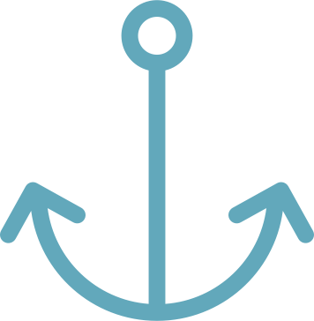


Know your Battlefield:
Assess Relative Fleet Strengths
Count ships
Assess firepower
Maximize advantage
Tally the total number of ships on your side and the opponent's side.
Add up the number and size of cannons across all ships on both sides.
Seek to have more ships and more/bigger guns than the opponent.
Knowing you have the numerical and firepower advantage boosts morale and tactical options.
Notes:
Source: American battle field trust

Slide 5
Employ Superior Tactics:
Firepower and Mobility
Target the Enemy Flagship
Line Formation
Arrange your fleet in a single line one behind the other to bring all guns to bear on the enemy.
Concentrate fire on the enemy flagship to disrupt their command and control.
Concentrated Firepower
Coordinate Maneuvers
Signal fleet movements to maximize firepower and evade return fire.
Focus your ships' broadsides for maximum firepower on a single target ship.

Slide 6

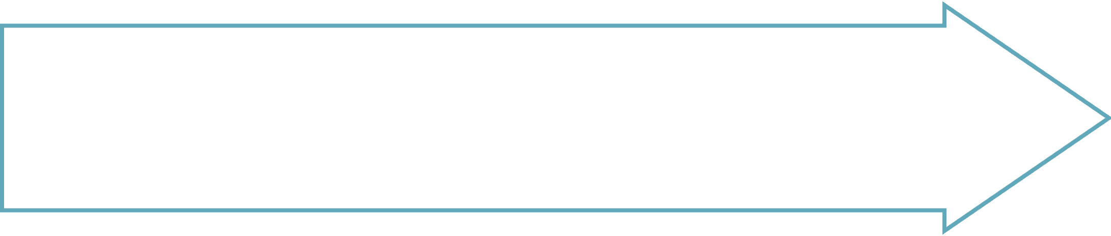
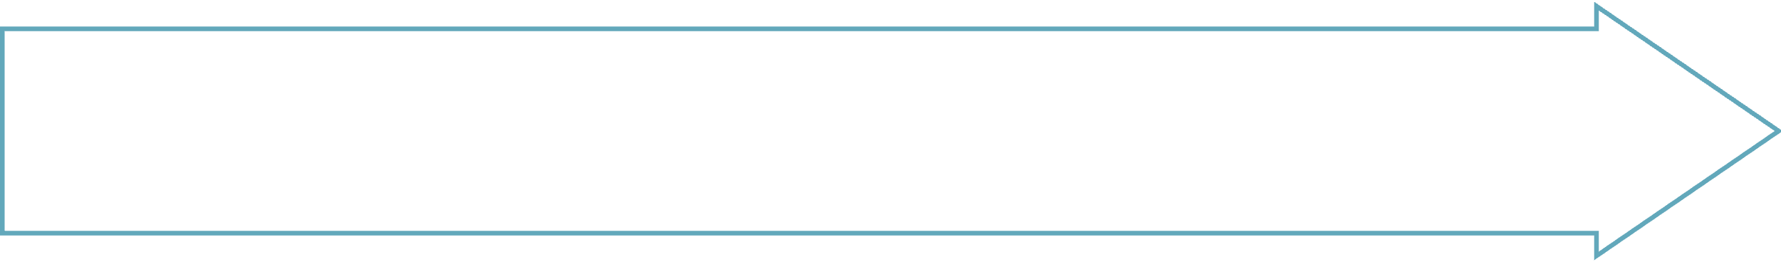
Gain weather gauge position
Secure Advantageous Positioning
Flank enemy ships
Maintain positional advantage

Slide 7

Maintain High Morale
Remind crews that success depends on working together and following orders.
Notes:
So we can achieve success when problems occur

Slide 8
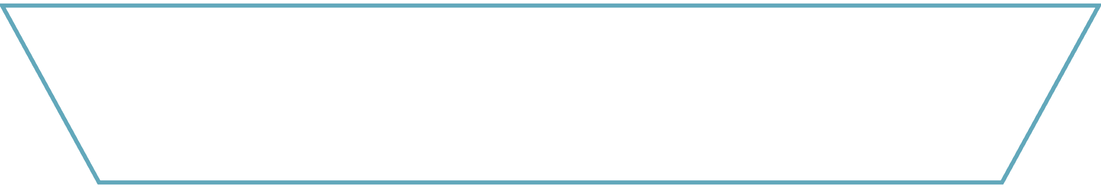



Summary of:
Strategy to Win an evenly matched battle
1
Focus fire to cripple lead enemy ships
2
Concentrate fire on damaged ships
3
Seize opportunity to divide enemy formation
4
Maintain pressure and momentum against disorganized foe

Slide 9
References
Encyclopædia Britannica, inc. (n.d.). Naval warfare summary. Encyclopædia Britannica. https://www.britannica.com/summary/naval-warfare
Naval battles. naval encyclopedia. (2022, October 24). https://naval- encyclopedia.com/naval-battles.php
Naval tactics in the American Revolution. American Battlefield Trust. (2023, December 14). https://www.battlefields.org/learn/articles/naval-tactics- american revolution#:~:text=Eighteenth%2Dcentury%20naval%20tactics%20emphasized, hand%2Dto%2Dhand%20combat.

